Slide 1
5 Shot Exercise
K. HARIHARAN
Mahindra Ecole Centrale

Slide 2
Introduction
The main purpose is to see how we can translate word into image or vice versa
While words have a rather narrowed meaning, visuals tend to move into more imaginary zones
With the intent to strike a balance it is useful to compose words with imaginary zones and then seek how to translate them in turn, into newer images
One must also remember that every word has a Meaning and a Feeling attached to it, be it a proper or common noun, verb or adjective

Slide 3
Where the mind is without fear and the head is held high
Where knowledge is free
Where the world has not been broken up, into fragments
By narrow domestic walls
Where the mind is led forward by thee
Into ever-widening thought and action
Into that heaven of freedom, my Father,
Let my country awake
Rabindranath Tagore
When will this thirst for Freedom slake?
When will our love of slavery die?
When will our Mother’s Fetters break?
When will our tribulations cease?
Are famine and disease alone our share?
For whom then are the laurels and rewards?
Where is your Dharma? Your duty?
To Revive us and chase Fear Away
Subramania Bharati
Some Ideal Poems

Slide 4
Methodology
The best way to seek a meaningful way to translate word into image is to understand the following nuances in such a transference
The word is at first a Symbol and so can the image become one: E.g If you say ‘Baap Rey!’ you are certainly not referring to your father!
What are the symbolic ways that different Ideas can translate from Words/ Sentences into Visual Symbols? Just think
What kind of symbolic expressions do we use whether intentionally or unknowingly?

Slide 5
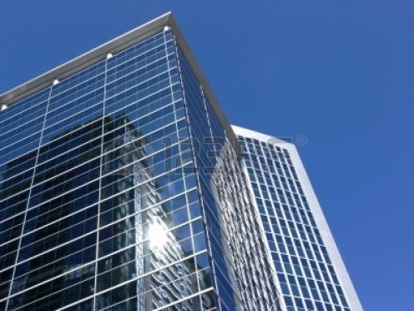
More methods
The Metonym:
A word/ image or expression used as a substitute for something with which it is closely associated
E.g. New Delhi for Indian Government or the Charminar for ‘Hyderabadi’ culture; or thrown away carry bags for pollution
Glass facades for modern companies; treadmills as symbols of good health

Slide 6
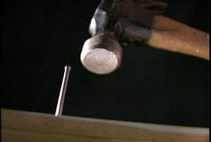
More methods
The Simile:
A word which brings about a well-known comparison between one thing and another; Quite often we hear of such aphorisms in our local languages
As hard as nails; soft as silk; loyal as a dog
Think of similar such expressions in your language or other current usages

Slide 7
More methods
The Metaphor:
A figure of speech in which a word is applied to something to which it is not literally applicable
Food for thought; cool as a cucumber etc.
The Red ‘Kumkum’ on the hair-parting as a symbol of marriage
Rakhi as a symbol for a ‘protective’ brother
The green dot indicating ‘vegetable’ only

Slide 8
More methods
The Antonym:
A figure of speech or word which is the opposite of another
Hot as a brick of ice etc.
Contradicting a piece of information to create a sort of satirical effect
E.g. Politicians are the most honest people on this planet

Slide 9
Ways of Writing/ Saying the text
The text can be
Illustrative
Supplementary
Contradictory or
Abstract
timing and spacing

Slide 10
Writing/ Saying the text
You may speak it out solo or as a dialogue between two or more persons
You may accompany it with live music and effects, live at the time of recording
You may speak it flat, normal & emotional, or even sing it out
If you are using an already written poem or text, please acknowledge the original author
It should be between 30 and 35 seconds to be synchronized with 5 images
Since Time at the studio is short, you have to come well rehearsed and planned

Slide 11

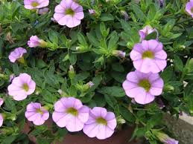
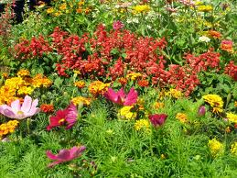
The Visual Composition
Bringing together the following Elements or Components make for the Composition
Volumes - Scale of Importance
Close Up (CU); Mid Shot (MS); Long Shot (LS)
The above three Volumes are usually based on the Human anatomy but for our purpose it is about how close you are to the subject e.g.
CU
MS
LS

Slide 12
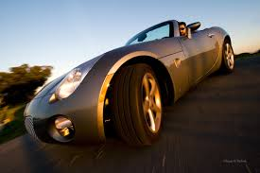

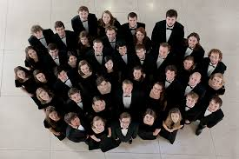
The Composition
Angles - Level of Significance
Low Angle: Looks at the subject from below
Eye level: Looks at the subject straight
Top Angle: Looks down on the Subject
Conventionally however Associations have been made with Low angle symbolizing ‘larger than life’ and Top angle meaning ‘made to look small’

Slide 13
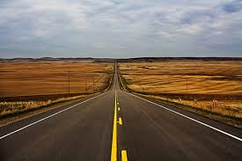
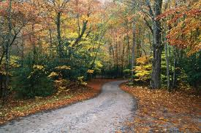
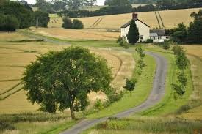
The Composition
Lensing - Perception/Depth
Wide angle: Covers a wide area from Foreground to Background
Normal Lens: Gives the Feeling of a normal view;
Telephoto Lens: Squeezes the depth and brings farther objects closer
The lens introduces the concept of specific focus and also plays around with depth of field. Both features are unavailable to our eyes!

Slide 14
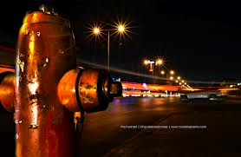
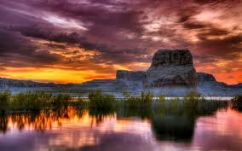
The Composition
For any composition to be effective try to see that there is some significance to the subject in terms of Foreground, Mid-Ground and Background
These 3 layers synthesize in unique ways to create a Meaning by leading the eye into a process of telling a story
Objects in these layers could also move in meaningful ways to create meaning

Slide 15
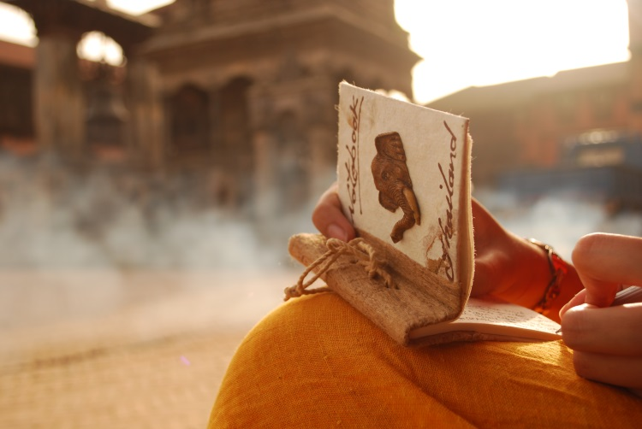

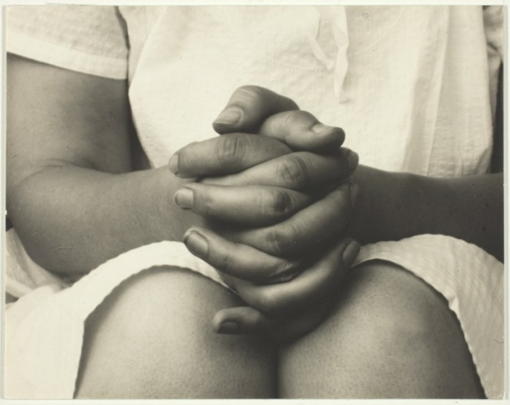
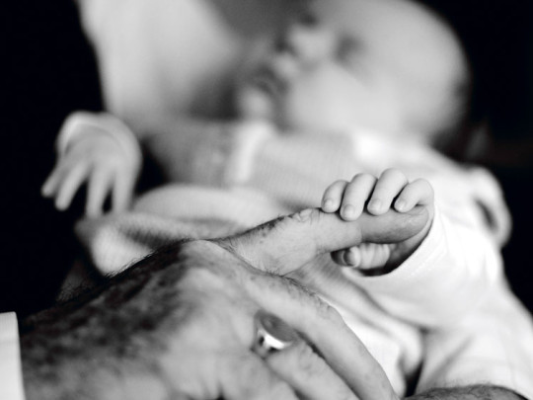
Some more samples
timing and spacing

Slide 16

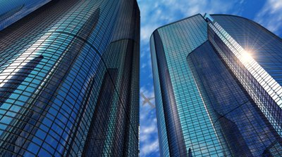
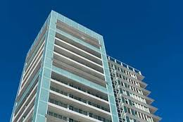
timing and spacing

Slide 17
Some Ground Rules
In whatever way you choose, the poem must relate to something that was discussed in the SE 101 classes
The project must have some genuine social concerns that you want to express
E.g What are your thoughts about our energy usage and its Crisis today? Or What is going to be the social impact of air/ water pollution? Your opinion on India’s growth Policies; the impact that educating a girl child will have on our technological future etc
When you shoot make sure, at least one image must deal with issues of today’s modern industrial age
timing and spacing

Slide 18
Some Ground Rules
You must film only the surroundings or objects in our campus and if possible without any interference to it from your side on the appointed day/ time
There should be perfect coordination within your six member crew so that all 30 shots are completed in one six hour period.
But you are free to “Carefully” arrange props/ installations/ signboards on locations for the purpose of describing your ideas
Humans cannot be used except as details or in long shots or as silhouettes. In short they shall not directly convey the feelings of the words

Slide 19
The Parameters
Every student has to get the text approved by one of the four SE 101 faculty members before the shooting in order to take part in the assignment
Each student will be provided a specified time for recording his or her ‘own’ voice in the studio.
Every student will get only 5 minutes to record the voice- over of 30 seconds for the exercise
The text can be in the language of the student’s choice
The recorded voice will be downloaded into the system and properly classified
Next , they shall shoot on the scheduled day

Slide 20
The Parameters
The moving images or shots should be static i.e. with no panning or tilting movements
The camera shall not be taken out of the tripod
Do not shoot more than required!
The shots should use all the compositional elements in different ways in order to convey the desired meaning
The shots should be taken within six hours inside the campus by each group on the allotted day/ time
At the end of the day they should be edited to the pre-recorded sound within the minimum time allotted
There shall be no special effects used in the editing except for simple dissolves

Slide 21
Assessment
Every student will be given 3 to 4 minutes to present their project
The project will be shown once without sound and once with it
If the text is not in English, a good translation will have to be provided to the faculty in charge of assessment
Finally the student will have to justify his or her thought process to the jury

Slide 22
Final Objective
The jury will see the imaginative skills of the student in combining images and sound
They will assess the originality in the thought process displayed on screen
The jury will also look for the confidence with which the student defends his or her work and overall communication skills
The jury will also reward the collaborative processes employed by every team, if any

Slide 23
Dates to Remember
27th to 31st October- Script Approval Compulsory
1st and 2nd November- Camera Handling Classes
3rd to 7th November- Voice Recording for A Batch
8th and 9th Nov.- Shooting and Editing for A Batch
10th to 14th Nov.- Voice Recording for B Batch
15th and 16th Nov.- Shoot and Editing for B Batch
21st, 22nd & 24th & 25th – Presentation & Final Assessment
timing and spacing

